Slide 1
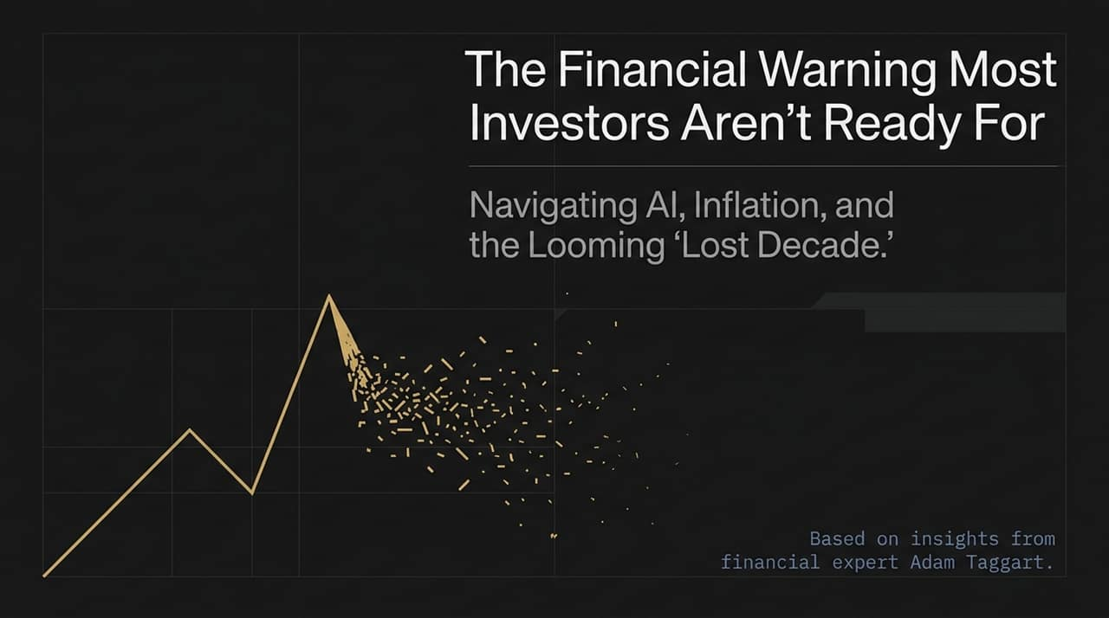
Notes:
Welcome & Frame: Good morning/afternoon, everyone. Today, we’re discussing a critical topic that affects every single person in this room: navigating the convergence of AI advancement, persistent inflation, and the looming threat of what economists call a 'Lost Decade'.
Context from the Video: This presentation synthesizes key financial principles and insights shared by Adam Taggart, host of Thoughtful Money, in his discussion on The Rubin Report.
Core Problem: Most people enter the workforce completely unprepared for the real mechanics of capitalism. As Adam notes, even top-tier graduates are rarely taught the practical mechanics of personal financial defense.
Session Objective: Over the next 15 slides, we will break down the essential 'financial muscles' you must build to shift from absorbing economic costs to becoming a resilient asset owner.
https://www.youtube.com/watch?v=Wr-mi4sxA8U

Slide 2
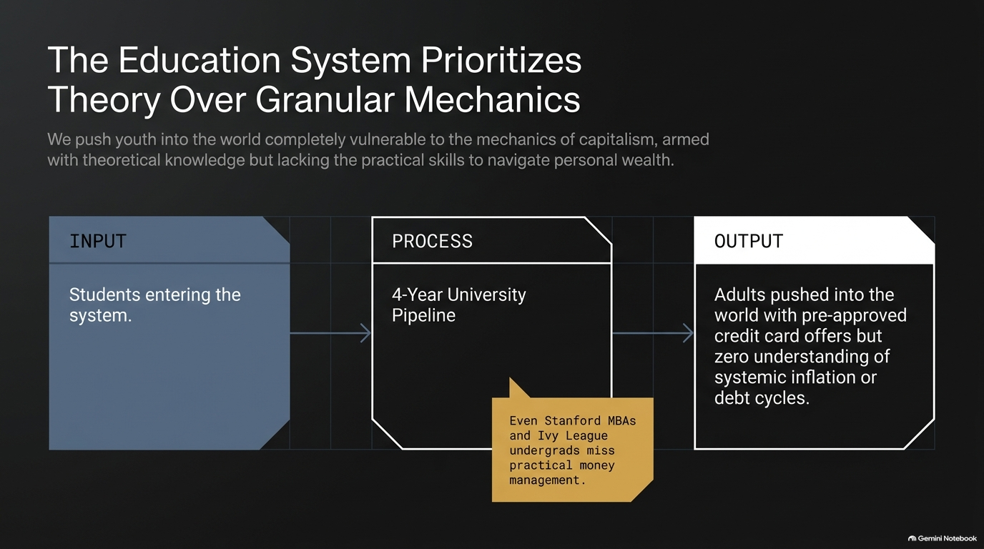
Notes:
The Structural Failure: Look at the pipeline on this slide: Students enter the four-year university system, consume theoretical concepts, and are pushed out into the world.
Adam Taggart’s Personal Insight: In the interview, Adam shares a striking personal background: he attended an Ivy League undergraduate program at Brown and earned his MBA at Stanford. Yet, throughout his elite education, he was never taught practical money management—how credit cards work, how to navigate mortgages, or how to build an investment framework.
The Real-World Output: Instead, young adults graduate and immediately open their mailboxes to pre-approved credit card offers without understanding debt cycles or systemic inflation.
Takeaway: We send people out into the market armed with abstract theory, but leaving them highly vulnerable to predatory credit practices.

Slide 3
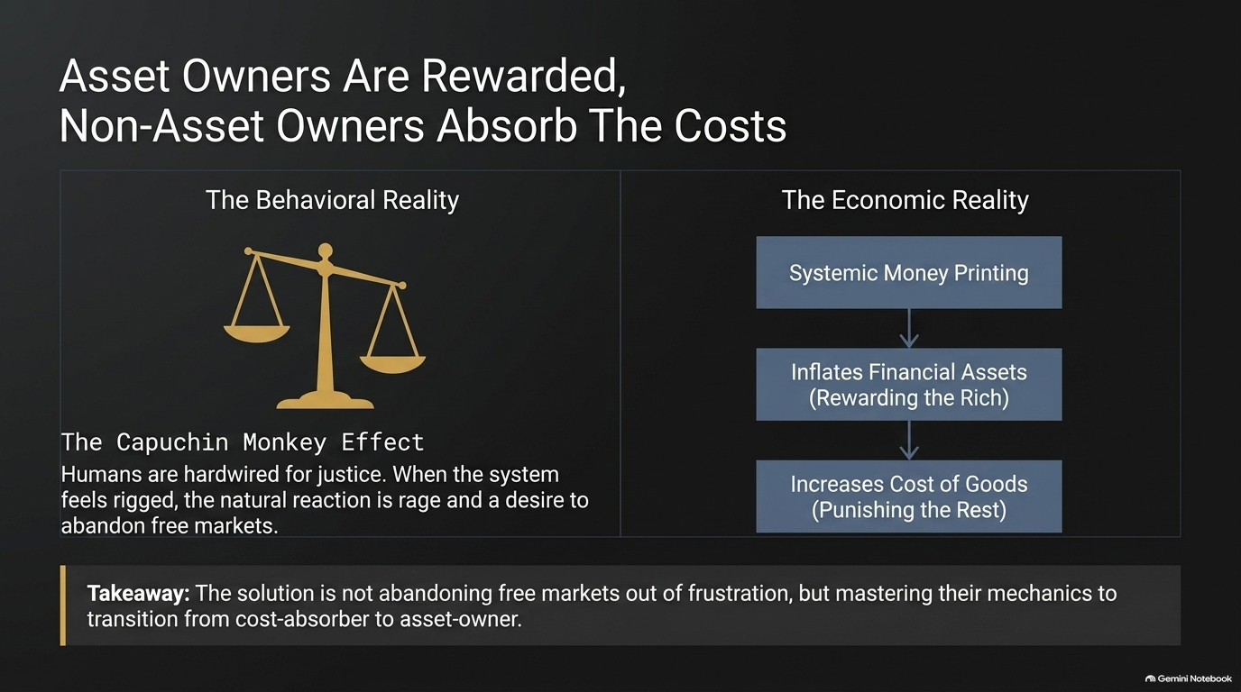
Notes:
Economic Mechanism: To understand wealth inequality, we have to look at monetary policy over the past two decades. When central banks print money, financial asset prices rise—benefiting asset owners (typically the wealthy minority).
The Non-Asset Owner Trap: For everyone else—those without assets—monetary expansion simply inflates the cost of living. They suffer the loss of purchasing power without receiving any offsetting asset growth.
The Capuchin Monkey Experiment: Adam highlighted a famous experiment in behavioral economics: Two capuchin monkeys are perfectly happy earning cucumbers for pushing a lever. But when one monkey starts receiving grapes (a higher value reward), the second monkey throws a rage fit and hurls its cucumber back at the researcher.
Behavioral Reality: Humans are hardwired for fairness. When the wealth gap widens due to systemic cantillon effects, society reacts with rage and anti-capitalist sentiment.
Call to Action: The solution is not throwing away free markets; the solution is learning their mechanics to transition from cost-absorber to asset-owner.

Slide 4
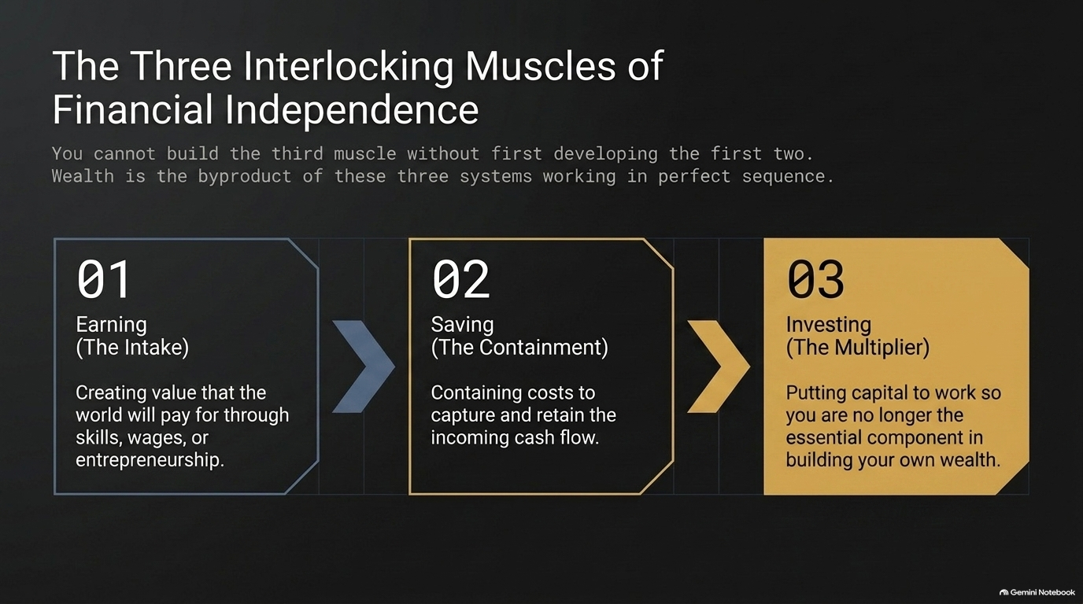
Notes:
Sequential Framework: Financial independence isn't about jumping straight to stock picking. It relies on three sequential muscles:
Earning (The Intake): Creating value through skills or entrepreneurship that the market willingly pays for.
Saving (The Containment): Controlling lifestyle creep to capture and retain incoming cash flow.
Investing (The Multiplier): Allocating capital so it compounds and removes you as the sole bottleneck for wealth creation.
Why Sequence Matters: You cannot build muscle #3 without mastering muscles #1 and #2 first. If your containment (saving) leaks, no amount of earning will make you wealthy.

Slide 5
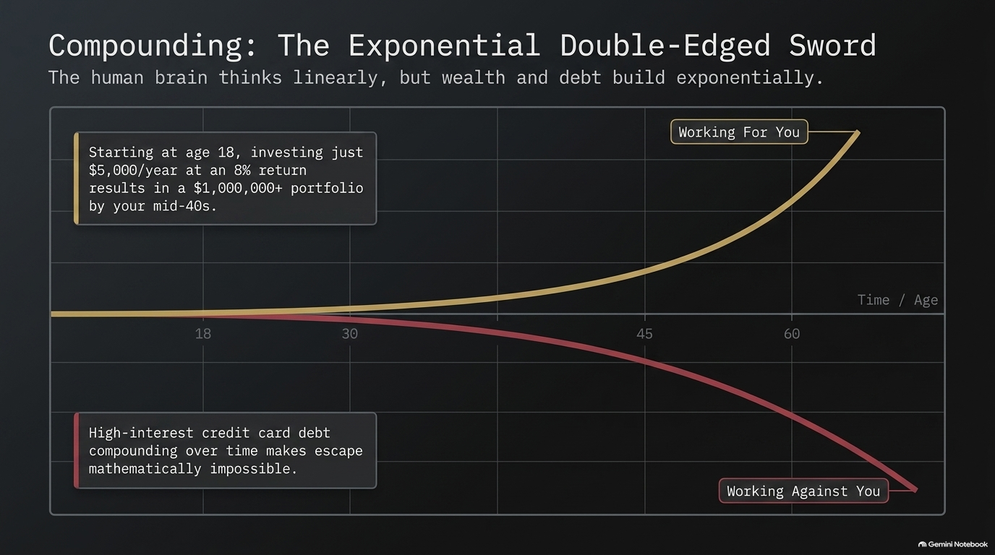
Notes:
Cognitive Limitation: Human brains are wired to think linearly, but compounding operates exponentially.
Positive Compounding: During the video interview, Adam pulled up a live spreadsheet calculation: If an 18-year-old invests $5,000 per year at an average 8% return, they will hold over $1,000,000 in their 40s/50s. Time is the greatest component in this formula.
Negative Compounding: Conversely, high-interest debt compounds against you with the exact same exponential power. That late-night $20 pizza bought on a 20% APR credit card in college can end up costing hundreds of dollars over time if left unpaid.

Slide 6
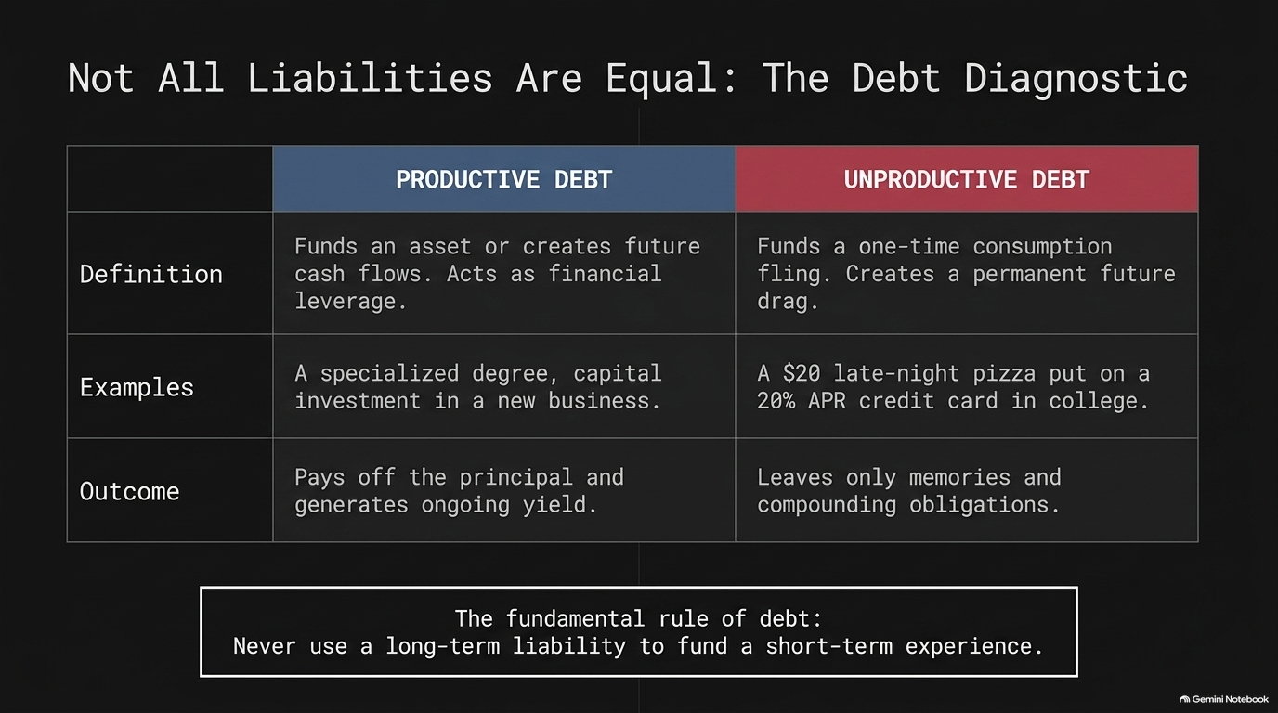
Notes:
Evaluating Debt: Debt is a tool that cuts both ways. The key is running every liability through a diagnostic framework:
Productive Debt: Funds an asset or income generator. Examples include specialized educational degrees with high ROI or capital expenditures for business expansion. Productive debt pays off its own principal and leaves you with yielding assets.
Unproductive Debt: Funds short-term consumption (dining out, vacations, consumer goods). It creates an enduring financial drag with zero long-term yield.
The Fundamental Rule: Never use long-term, high-interest liabilities to fund short-term experiences.

Slide 7
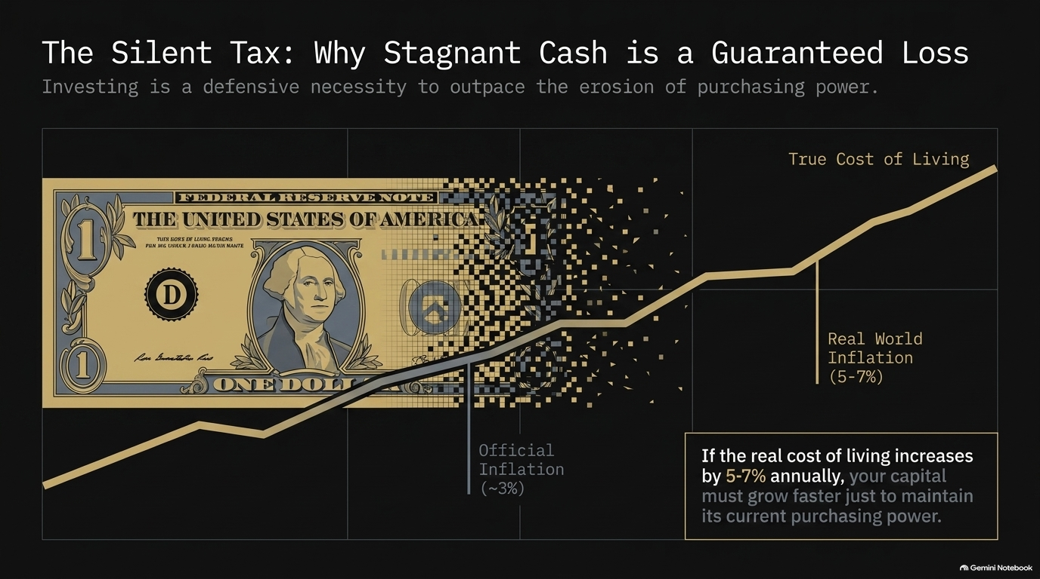
Notes:
The Myth of 'Safe' Cash: Holding excess cash in traditional savings accounts isn't safe—it is a guaranteed real-value loss due to inflation.
CPI vs. Reality: While official government inflation statistics (CPI) report figures around 3%, real-world costs—housing, healthcare, education, quality food—frequently inflate at 5% to 7% annually.
Re-defining Investment Goals: As Adam emphasizes, the primary goal of investing isn't get-rich-quick speculation; it is defending your hard-earned capital so it stays ahead of real inflation and maintains purchasing power.

Slide 8
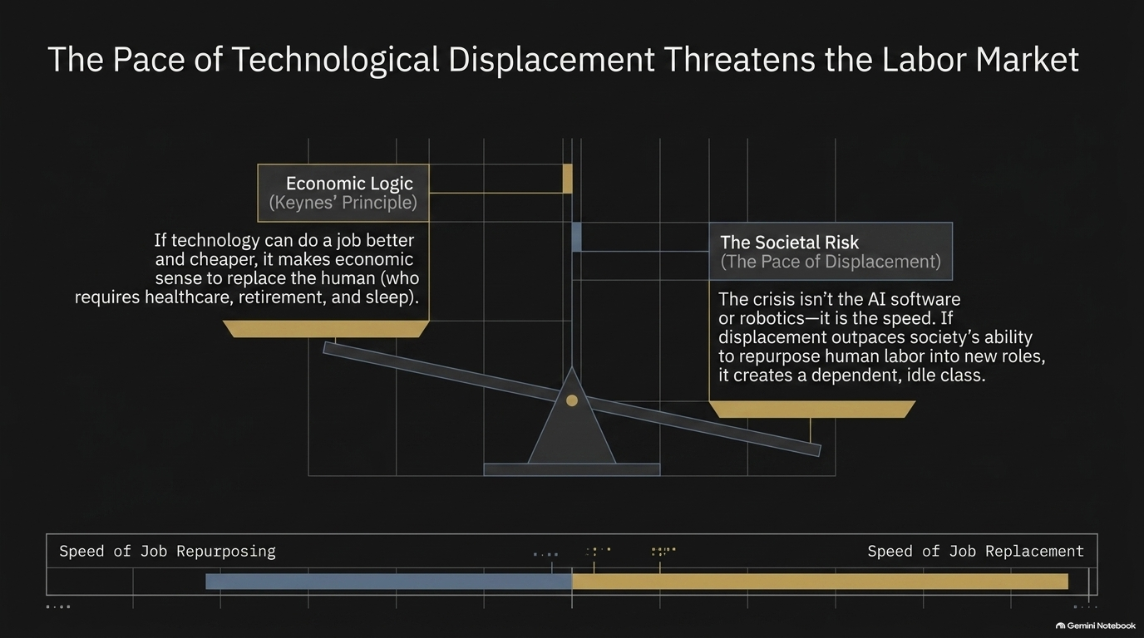
Notes:
Incentive Alignment: Why are companies rushing into AI and robotics? Because human workers are expensive, complex, require benefits, healthcare, and rest.
Keynesian Principle: Economist John Maynard Keynes introduced the concept of technological displacement: replacing human labor with superior, cheaper technology makes microeconomic sense.
The Macro Threat: Keynes warned that the danger is the pace of displacement. If AI and automation displace tens of millions of service and knowledge workers faster than society can retrain them for new roles, it creates widespread structural unemployment and social friction.

Slide 9
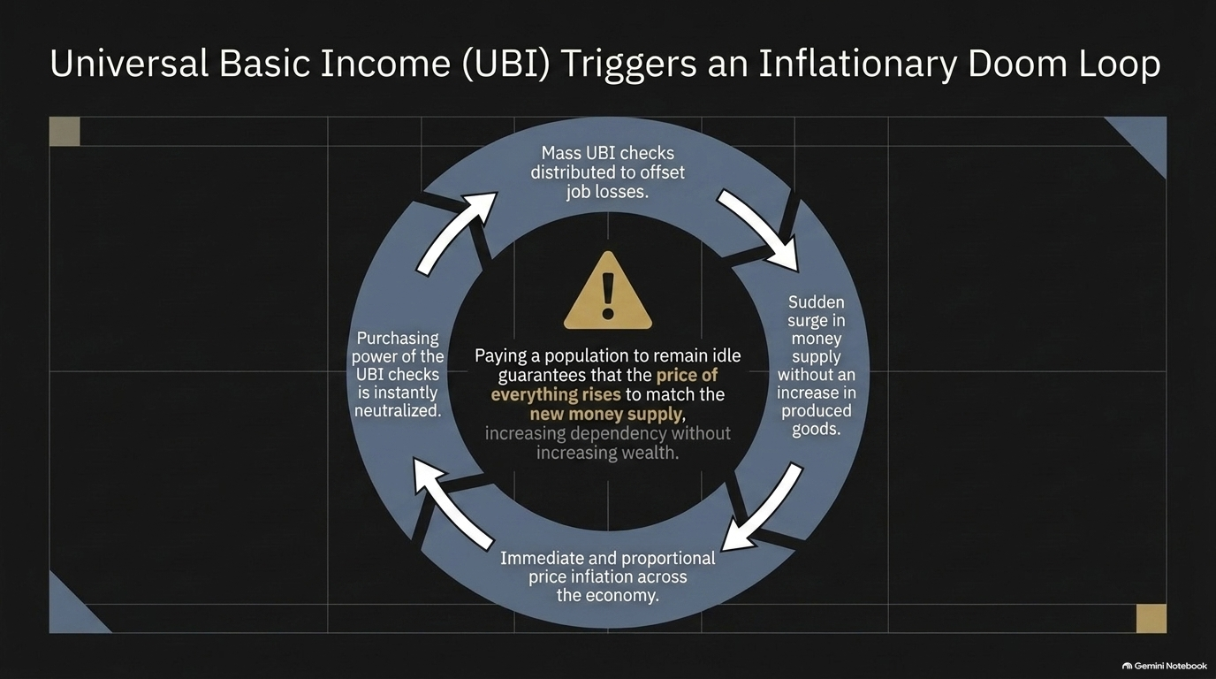
Notes:
The Proposed Solution: When mass job displacement occurs, politicians often propose Universal Basic Income (UBI).
The Economic Doom Loop:
Millions receive UBI checks without producing corresponding goods or services.
Aggregate demand remains constant or surges, but actual production lags.
Immediate price inflation offsets the purchasing power of the checks.
Citizens require larger UBI checks, continuing the cycle.
Conclusion: Paying populations to remain idle increases debt and inflation while eroding long-term productivity.

Slide 10
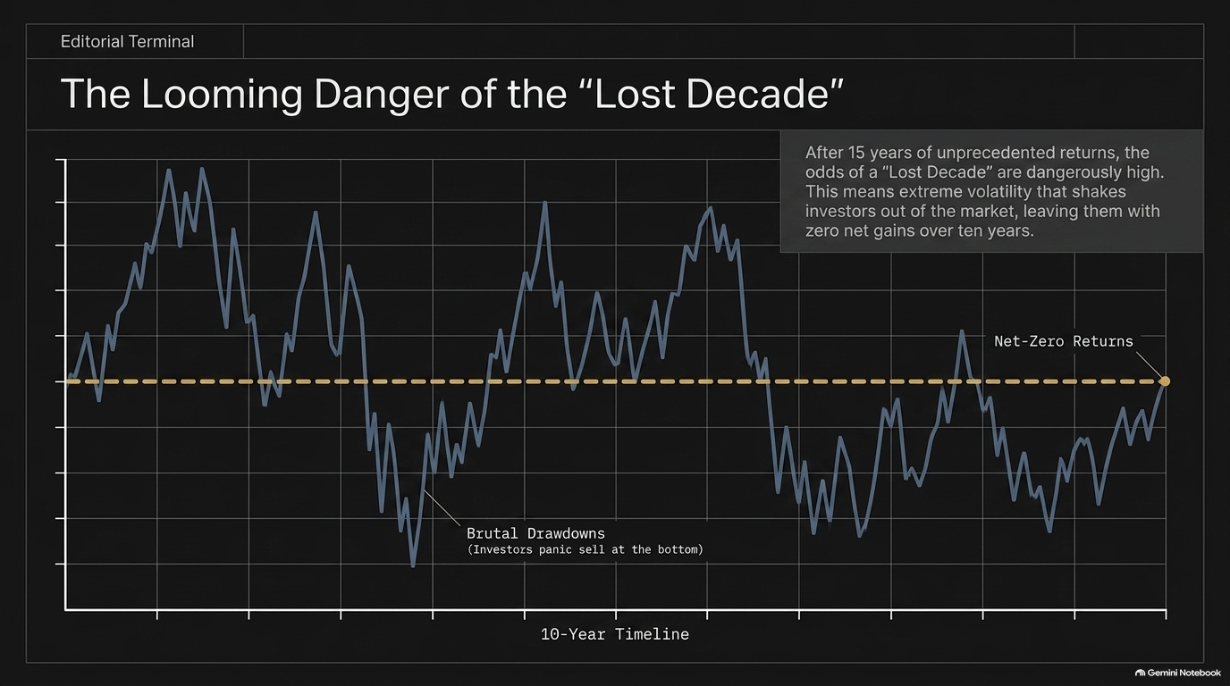
Notes:
Historical Context: Following 15 years of exceptional, central-bank-fueled equity returns, historical valuation models point toward a potential 'Lost Decade'.
What is a Lost Decade? A Lost Decade does not mean markets move in a straight line. It means severe 30–40% drawdowns followed by sharp rallies, resulting in zero net return over a ten-year horizon.
Psychological Ruin: Extreme volatility causes retail investors to panic and sell at the bottom, sit in cash during recoveries, and re-enter at peak valuations. Navigating this requires capital preservation strategies.

Slide 11
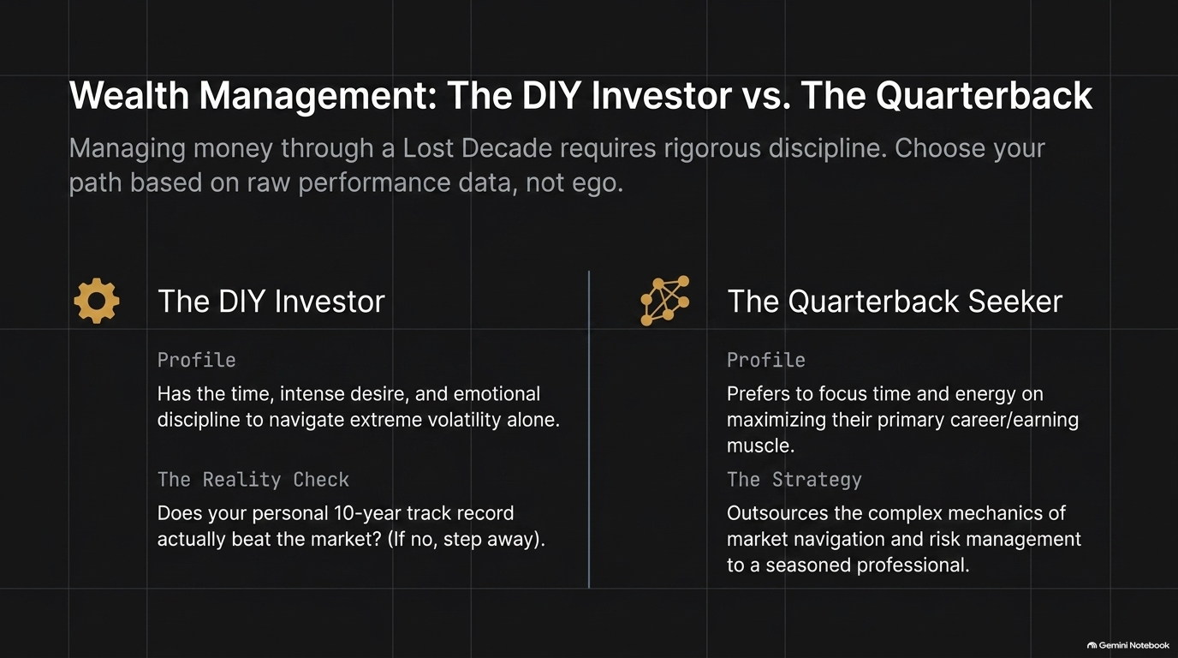
Notes:
Evaluating Your Approach: Investors face a choice: Do It Yourself (DIY) or hire a financial quarterback.
The DIY Reality Check: To be a successful DIY investor in volatile times, you need rigorous emotional control and research time. Look objectively at your 10-year track record. If you haven't consistently beaten key benchmarks, managing capital alone may be costing you net worth.
The Financial Quarterback: For professionals whose highest return on time comes from their primary career, outsourcing portfolio management allows them to focus on maximizing their primary earning muscle.

Slide 12
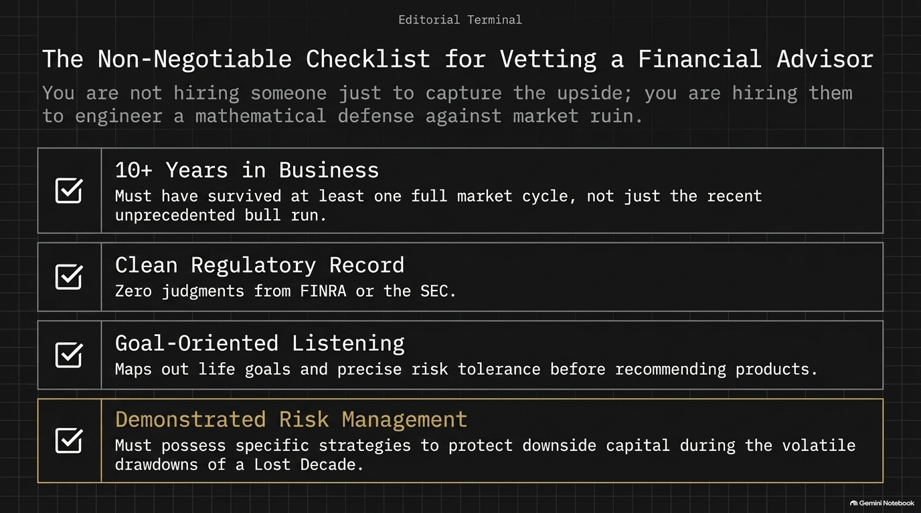
Notes:
Vetting Standards: If you choose to hire a financial advisor, run them through these non-negotiable criteria:
10+ Years of Track Record: They must have successfully managed money through multiple market regimes, including bear markets.
Clean Regulatory Record: Zero disciplinary actions or judgments from FINRA or the SEC.
Goal-Oriented Discovery: They prioritize listening to your life goals and risk tolerance over pitching pre-packaged investment products.
Active Downside Risk Management: They maintain clear tactical protocols to protect capital during severe market downturns.

Slide 13
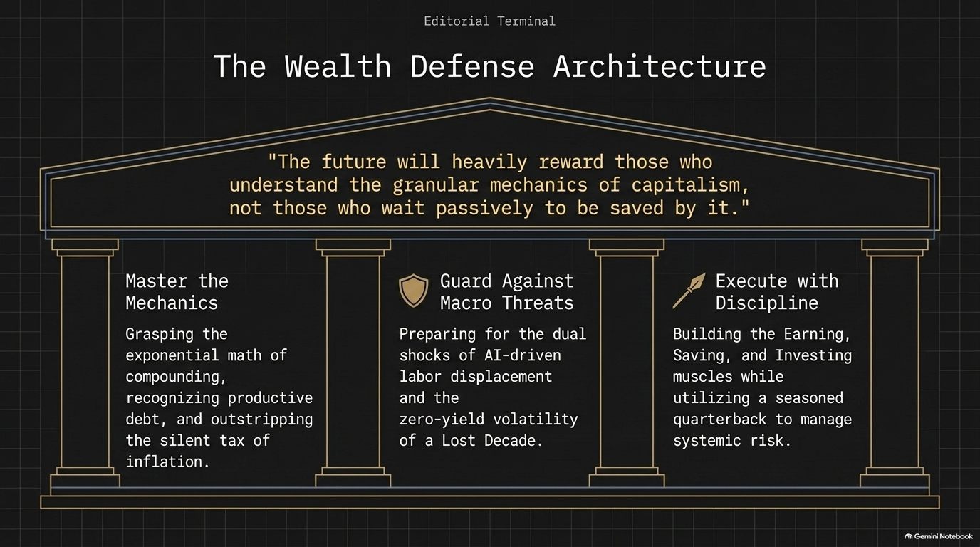
Notes:
Integrating the Framework: This architecture combines our core strategic pillars:
Master Mechanics: Exponential math, productive debt, inflation-hedging.
Guard Against Macro Threats: AI disruption and Lost Decade drawdowns.
Execute with Discipline: Build Earning, Saving, and Investing capabilities alongside professional risk management.
Takeaway: Economic shifts heavily reward those who proactively master capitalist mechanics rather than relying on external intervention.

Slide 14
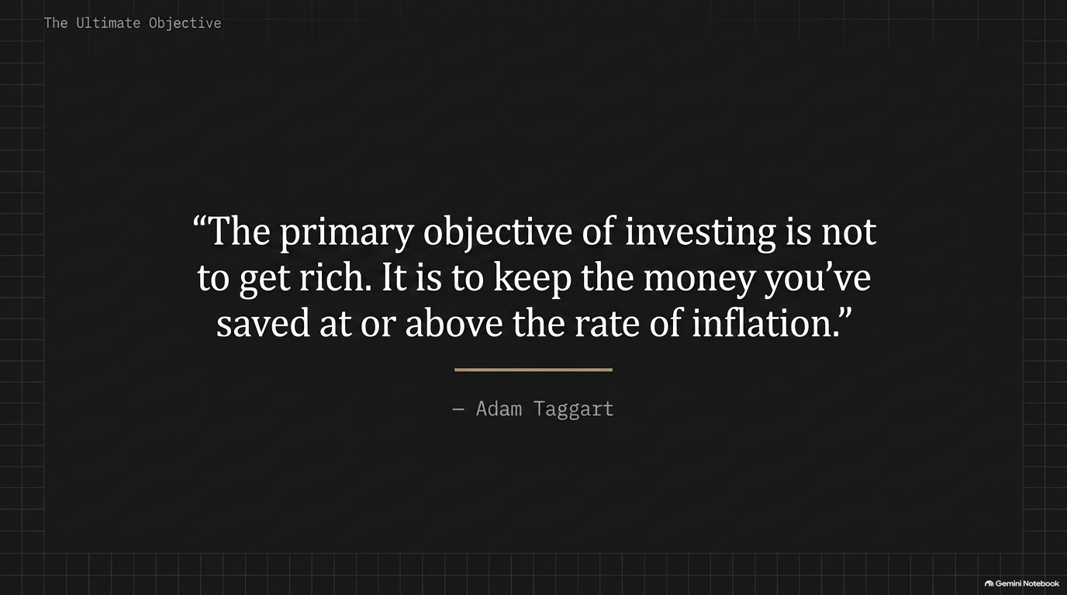
Notes:
Core Principle: Let’s anchor on this quote from Adam Taggart: 'The primary objective of investing is not to get rich. It is to keep the money you've saved at or above the rate of inflation.'
Summary: Focusing solely on upside gains leads to unhedged risk-taking. Prioritize capital preservation, and growth will compound over time.

Slide 15
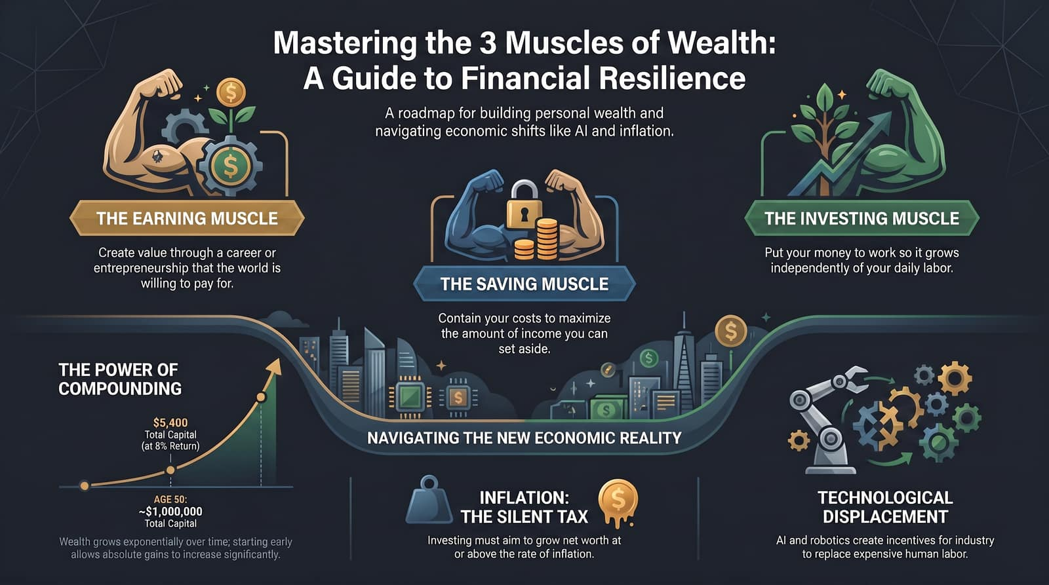
Notes:
Final Presentation Summary: This visual roadmap summarizes the core takeaways:
Build the Earning Muscle: Expand market value and career income.
Build the Saving Muscle: Maintain expense containment to free up investment capital.
Build the Investing Muscle: Put retained savings into productive assets to outpace inflation.
Respect Exponential Growth: Start early to leverage long-term compounding.
Prepare for Technological & Economic Shifts: Defend against real-world inflation and AI displacement by owning income-generating assets.
Closing: Thank you. Let’s open the floor to Q&A.

